Slide 1


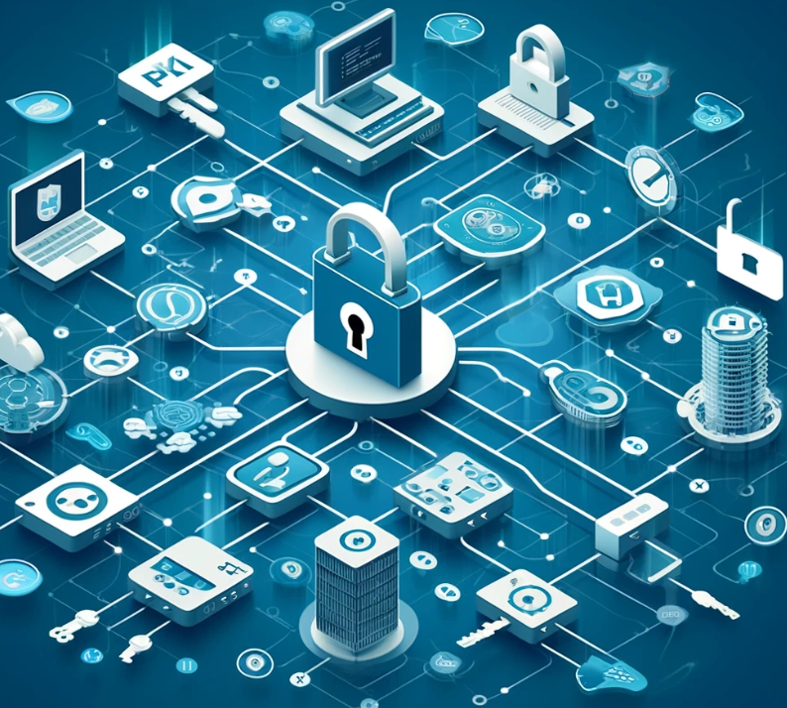



Top layer/text
Dec 13, 2024
Episode Details
Office Hours + This Week in Discourse
(two in one day?)
tv ‘noise’

Slide 2
Top layer/text
Dec 13, 2024
Episode Details
Exploring OpenZiti + LiveKit + pion/webrtc
tv ‘noise’

Slide 3



Top layer/text
Oct 25, 2024
Episode Details
Working Session and Office Hours!
tv ‘noise’

Slide 4

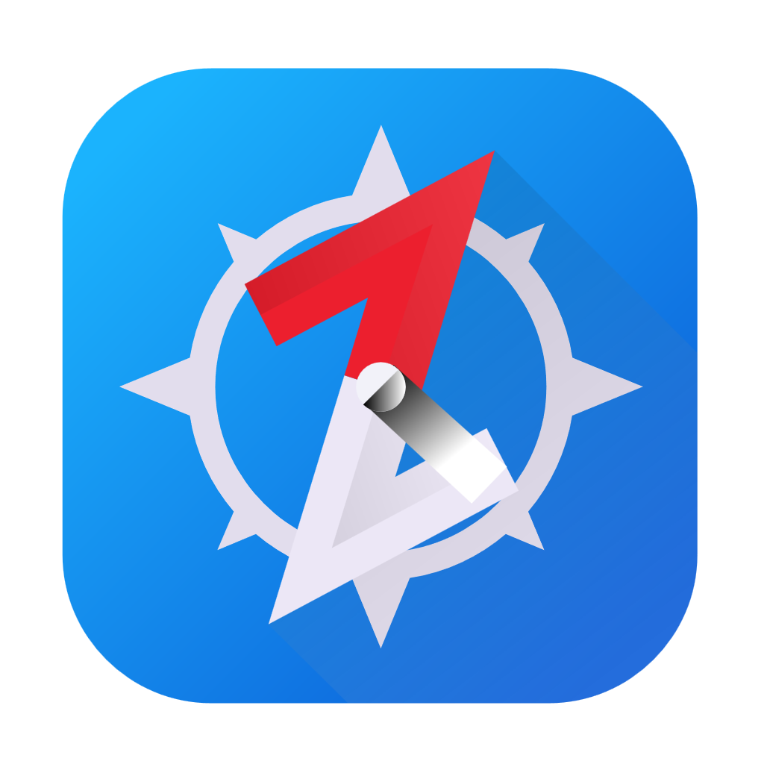
Top layer/text
Aug 30, 2024
Episode Details
BrowZer + ZAC Revisited
tv ‘noise’

Slide 5
Top layer/text
Aug 16, 2024
Episode Details
Let’s Build a Network
tv ‘noise’

Slide 6

Top layer/text
Aug 08, 2024
Episode Details
Demystifying zero trust!
tv ‘noise’

Slide 7
Top layer/text
Jul 12, 2024
Episode Details
Working Session and Office Hours!
tv ‘noise’

Slide 8

Top layer/text
Jun 14, 2024
Episode Details
OpenZiti, BrowZer, docker compose and self-signed PKI!
tv ‘noise’

Slide 9
Top layer/text
Jun 7, 2024
Episode Details
Exploring OpenZiti and Public Key Infrastructure (PKI)
tv ‘noise’

Slide 10
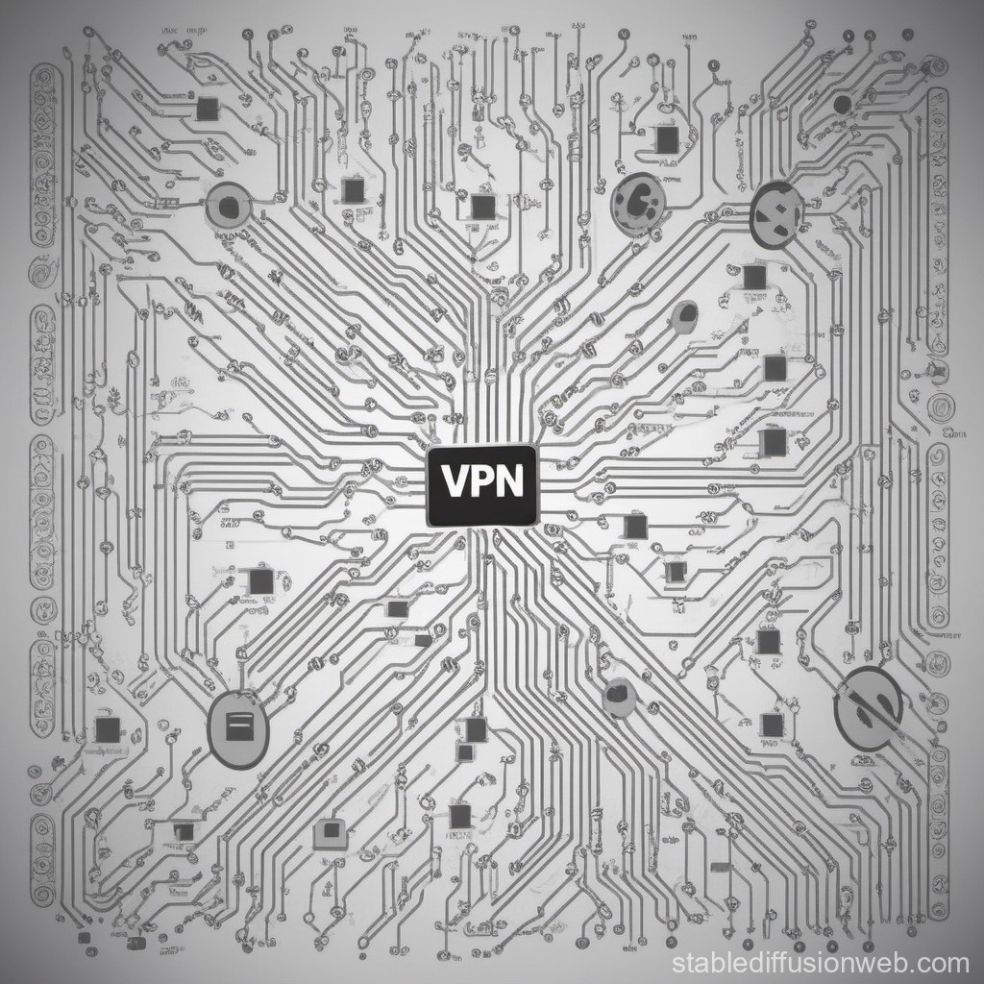

Top layer/text
May 10, 2024
Episode Details
zrok VPN
tv ‘noise’

Slide 11
Top layer/text
Apr 26, 2024
Episode Details
Building an Overlay
With Docker
tv ‘noise’

Slide 12
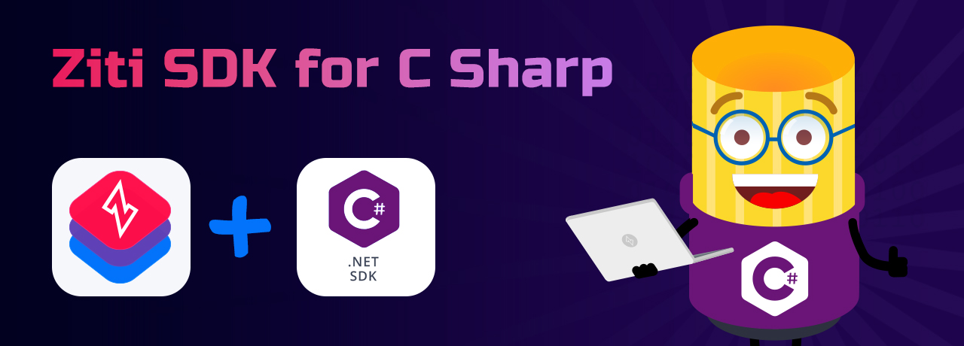
Top layer/text
Apr 19, 2024
Episode Details
Exploring the .NET SDK
tv ‘noise’

Slide 13
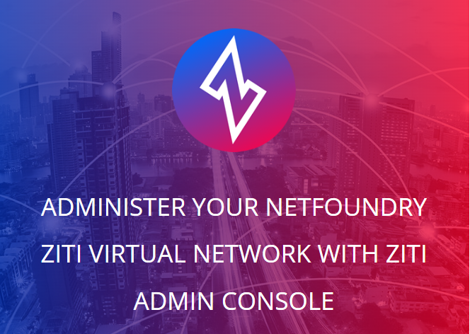
Top layer/text
Apr 11, 2024
Episode Details
OpenZiti – ZAC Primer
tv ‘noise’

Slide 14

Top layer/text
Mar 01, 2024
Episode Details
OpenZiti – step by step!
tv ‘noise’

Slide 15

Top layer/text
Jan 12, 2024
Episode Details
BrowZer + Keycloak!
tv ‘noise’

